Slide 1

CMR Technical Campus Department of IT
Major Project Stage-II Review-I
Project Title : A Centralized Student–Faculty Platform for Real-Time Academic Performance Prediction.
Project Supervisor:
Name : D Mahesh Babu
Designation : Assistant Professor
Presented By:
Batch No : 23
H. No: 227r1a1236 Name : M Anjali
H. No: 237r5a1204 Name : G Abhinav
H. No: 227r1a1238 Name : M Akhila Kumari

Slide 2
CONTENTS
Introduction and Overview of the project (Abstract)
Existing System
Disadvantages
Proposed System
Advantages
Hardware and Software requirements
Novelty of your Project
Architecture
Modules
UML Diagrams

Slide 3
INTRODUCTION AND OVERVIEW
Academic institutions generate large volumes of student performance data, but most existing systems only store information without providing meaningful analysis or predictions. This project proposes a Centralized Academic Performance Platform that collects student academic data and applies Machine Learning algorithms to analyze and predict student performance. The system classifies students into categories such as Good, Fair, and Poor, helping faculty and administrators identify weak students early and take corrective actions. It also provides separate dashboards for Admin, Faculty, and Students, improving transparency, communication, and decision-making.

Slide 4
EXISTING SYSTEM
The existing academic management systems mainly focus on:
Storing student records
Displaying marks and attendance
Manual performance analysis by faculty
Most systems do not support intelligent prediction, trend analysis, or early warnings for poor performance.

Slide 5
DISADVANTAGES
No performance prediction or analytics
Manual evaluation consumes time and effort
Difficult to identify weak students early
No centralized communication platform
No data-driven decision support

Slide 6
PROPOSED SYSTEM
The proposed centralized student-faculty platform integrates academic tracking, communication, and predictive analytics in one portal. It employs XGBoost and Naïve Bayes models to predict student performance levels, providing actionable insights with high accuracy. The platform enables:
Role-based dashboards for Admin, Faculty, and Students.
Automated notifications, attendance and mark management, and performance visualization.
Faculty suggestions based on ratings and reviews.
Structured feedback and faculty capacity control.
This system promotes proactive academic management and collaborative learning environments.

Slide 7
ADVANTAGES
Accurate prediction of student performance
Early identification of academically weak students
Reduced manual effort for faculty
Centralized and structured data management
Improved academic outcomes through data-driven insights

Slide 8
HARDWARE AND SOFTWARE REQUIREMENTS
Hardware Requirements:
Processor: Intel i3 or above
RAM: Minimum 8 GB
Hard Disk: 256 GB or above
Internet Connection
Software Requirements
Operating System : Windows / Linux
Frontend : HTML, CSS, JavaScript, React.js
Backend : Python, Flask
Database : MySQL
Machine Learning : XGBoost, Naïve Bayes
Tools : VS Code

Slide 9
NOVELTY OF YOUR PROJECT
The novelty of this project lies in the use of machine learning techniques to predict and categorize student academic performance at an early stage. Unlike traditional academic systems that only store and display data, this system analyzes student marks, attendance, and internal assessments to classify students into Good, Fair, and Poor categories. The project provides role-based dashboards for administrators, faculty, and students, enabling data-driven decision-making and timely academic intervention. By integrating centralized data management with intelligent prediction and performance monitoring, the system improves academic outcomes and supports proactive learning management.

Slide 10
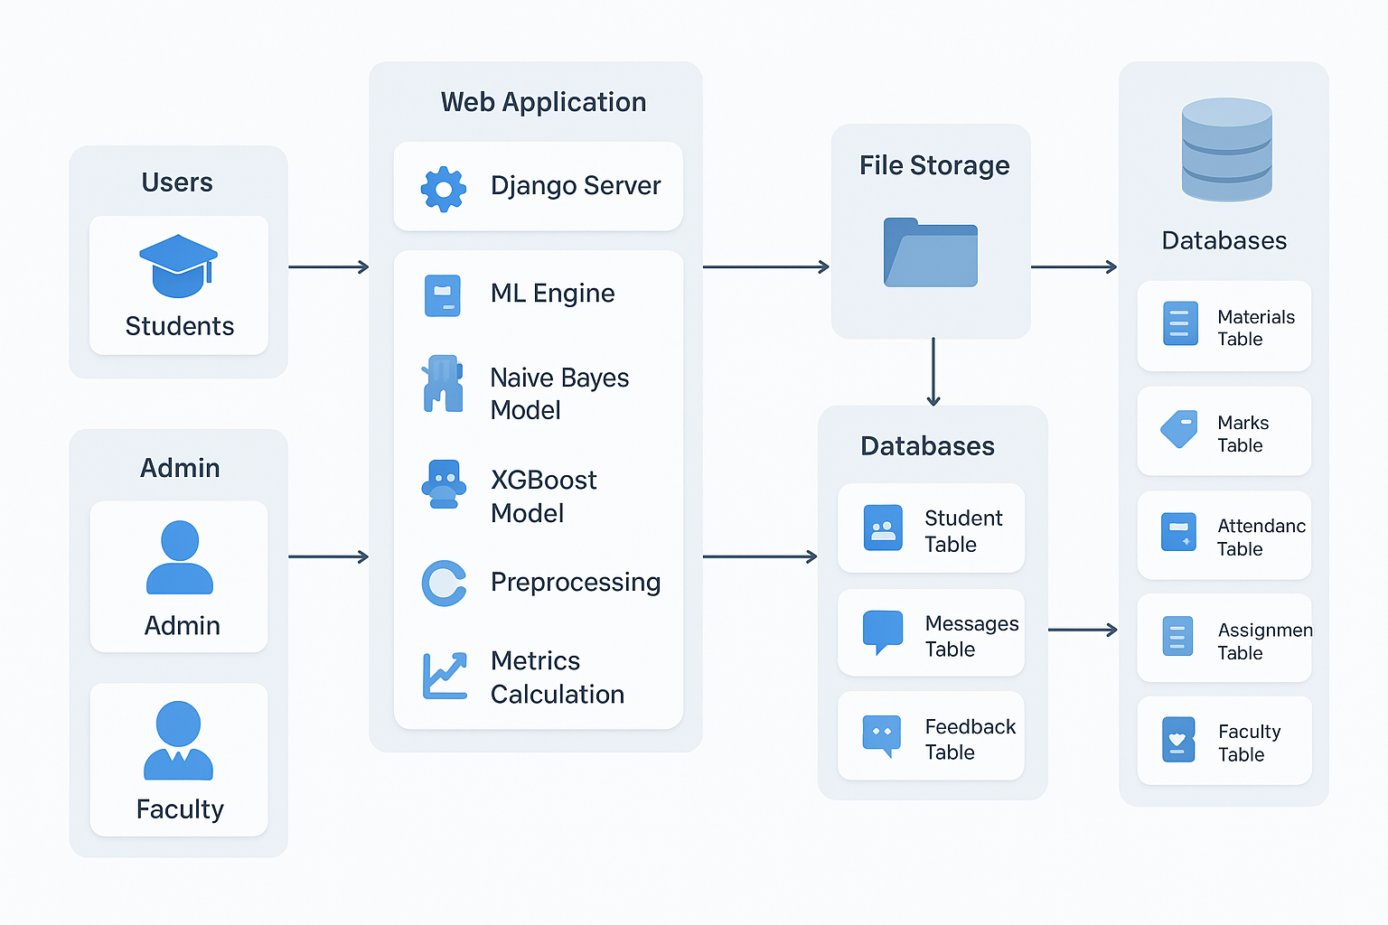
ARCHITECTURE

Slide 11
MODULES
1. Admin Module
Manage students, faculty, and subjects
View overall performance analytics
2. Faculty Module
Upload marks and attendance
View student performance predictions
3. Student Module
View academic records and predicted performance
Track progress over time
4. Prediction Module
Applies ML algorithms
Categorizes students based on performance

Slide 12
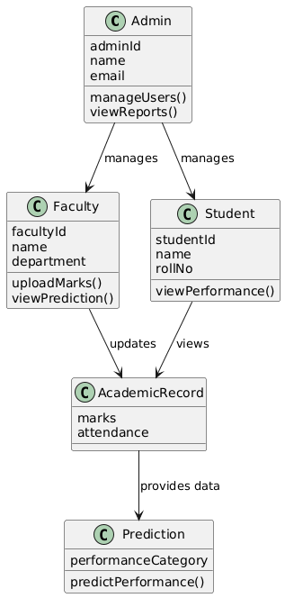
UML DIAGRAMS
CLASS DIAGRAM

Slide 13
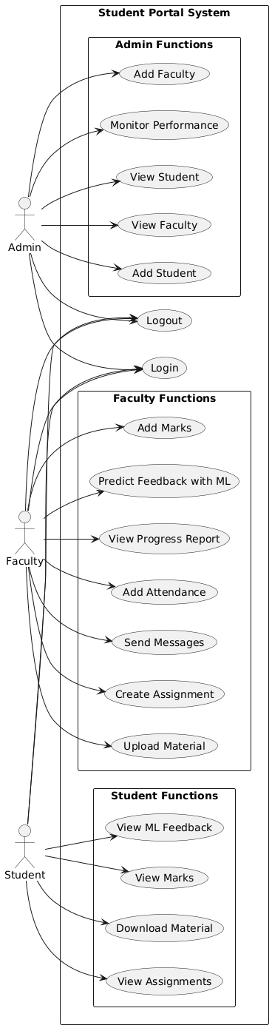
USE CASE DIAGRAM
Part 1
Part 1

Slide 14
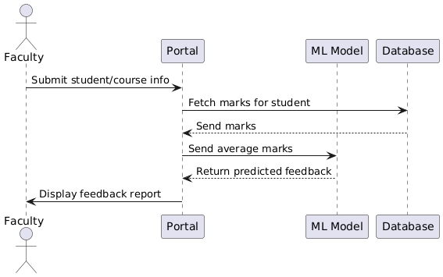
SEQUENCE DIAGRAM

Slide 15
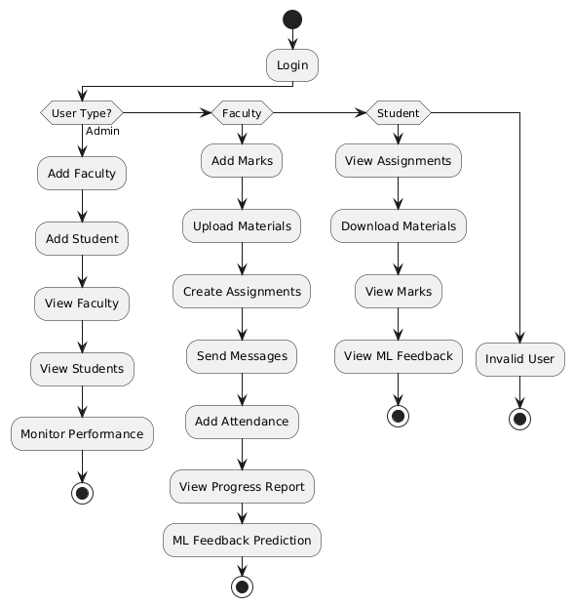
ACTIVITY DIAGRAM

